Slide 1


Titolo presentazione sottotitolo
SMBUD project – 2022/2023
Milano, XX mese 20XX
Group 10: Gabriele Ginestroni, Giacomo Gumiero, Lorenzo Iovine, Nicola Landini, Francesco Leone

Slide 2


Agenda
1
Assumptions and problem presentation
2
ER Diagram
3
Neo4J
4
MongoDB
5
Spark

Slide 3
Assumptions and problem presentation
Choosing the dataset
Why
Analyzing data
Citation Network Dataset by Aminer
JSON
Rich in attributes:
abstract
affiliations
publication details
Well organized
Unique IDs
Citations
Pandas profiling
Data distribution

Slide 4
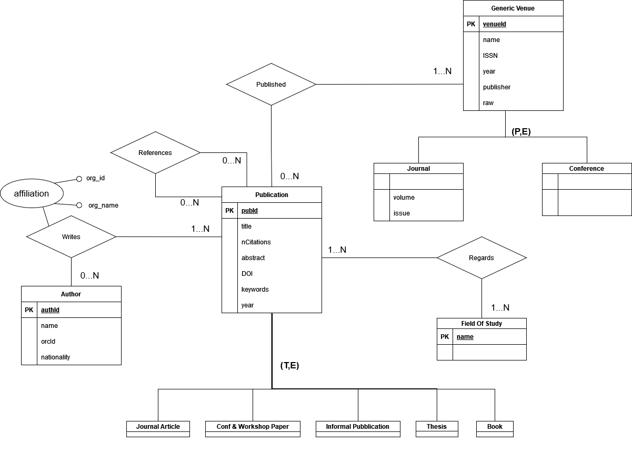
ER Diagram

Slide 5
Neo4j

Slide 6
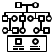
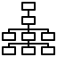


Neo4j
Nodes identification
Relationships identification
Pre-processing
Import

Slide 7
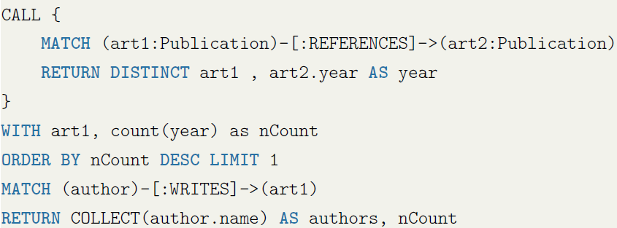
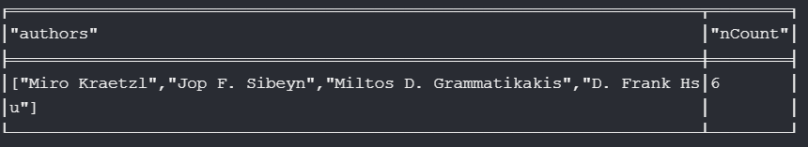
Neo4j - Query
Find the authors of the article that cites articles with the greatest number of different years of publication

Slide 8
MongoDB

Slide 9
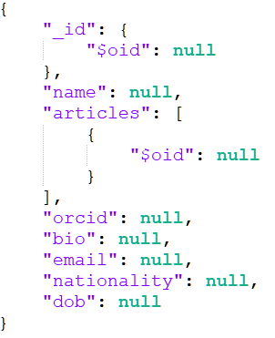
MongoDB – Author Structure

Slide 10
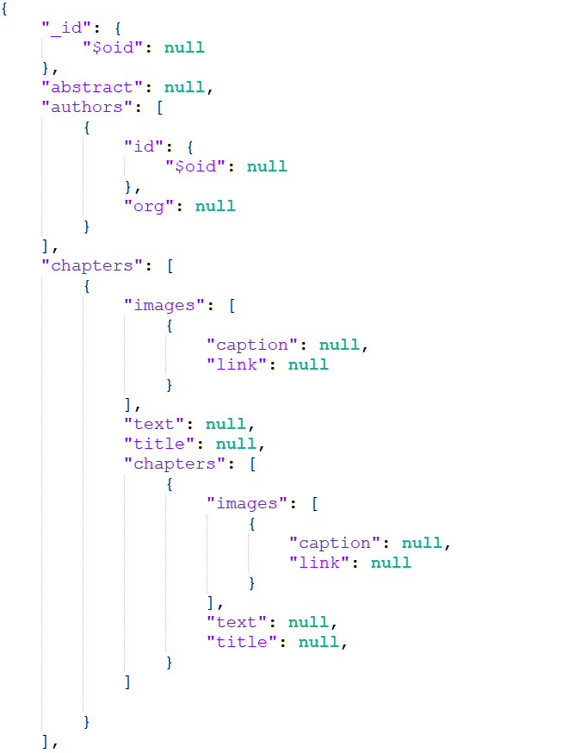
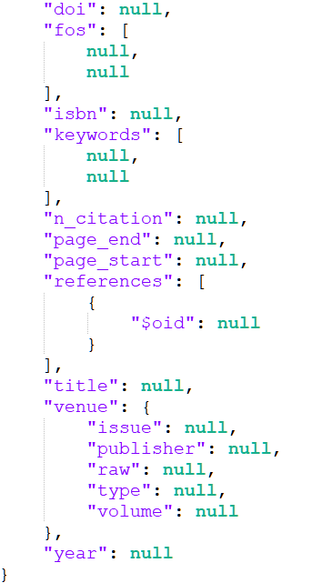
MongoDB – Article Structure

Slide 11
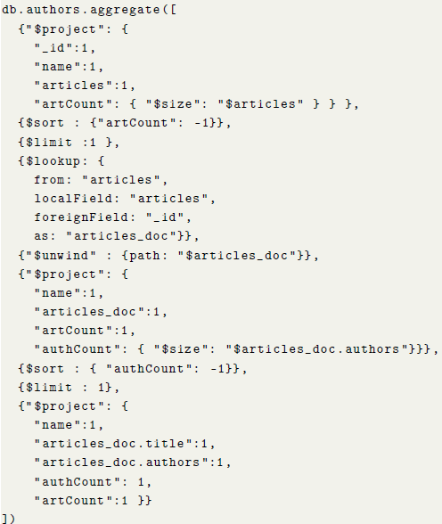
MongoDB - Query
This query finds the author with maximum amount of written articles and retrieves his article with the highest number of coauthors

Slide 12
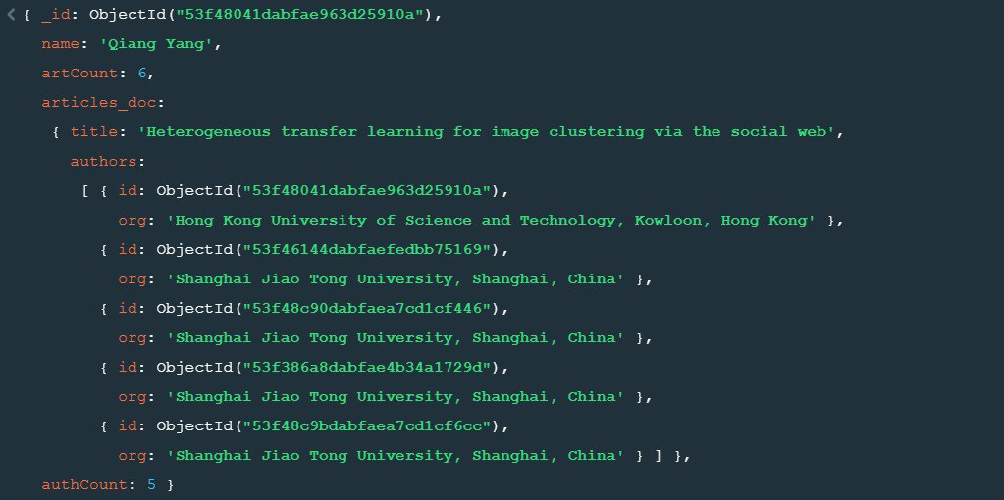
MongoDB – Query results

Slide 13
Spark

Slide 14
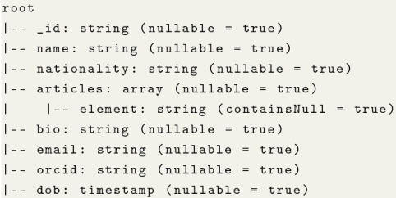
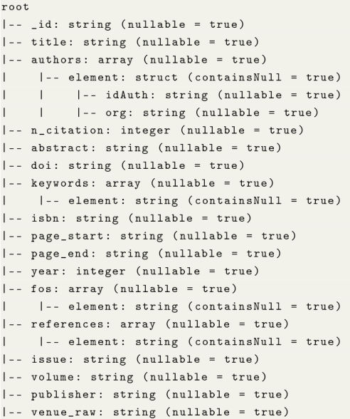
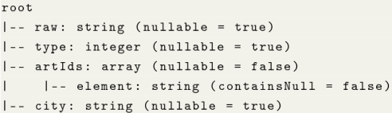
Spark – Data Structure
Author’s structure
Article’s structure
Venue’s structure

Slide 15
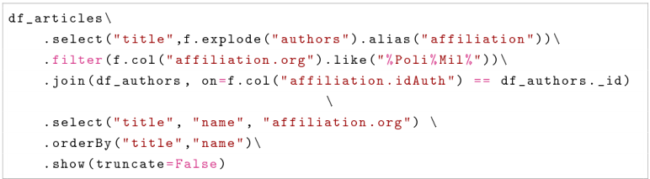
Spark - Query
This query returns all articles written in affiliation with “Politecnico di Milano”

Slide 16
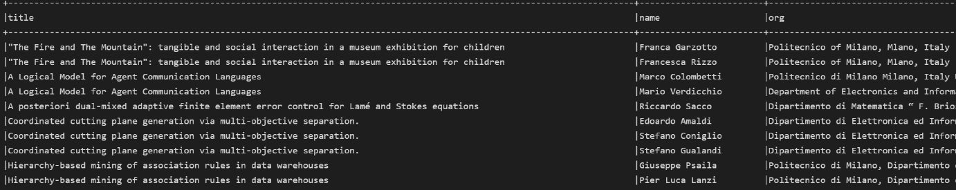
Spark – Query results

Slide 17

Firma convenzione Politecnico di Milano e Veneranda Fabbrica del Duomo di Milano
Group 10:
Gumiero Giacomo
Ginestroni Gabriele
Iovine Lorenzo
Landini Nicola
Leone Francesco
Thanks for your attention
Aula Magna – Rettorato
Mercoledì 27 maggio 2015

